Slide 1
CMake as used by the
Draco and Jayenne Projects
Presented to SWIFT
2012 Feb 6
Kelly Thompson, kgt@lanl.gov
CCS-2:12-06(U)

Slide 2
Outline
What parts of the CMake does Draco/Jayenne use?
Features with examples
Limitations and issues
Questions
Slide <number>

Slide 3
Draco, Jayenne and Capsaicin share the Draco Build System
CMake generates build projects from instructions provided in CMakeLists.txt files.
  Local CMakeLists + draco/config/*.cmake scripts
  Integrated with Draco development environment (standardized .bashrc, module files, editor defaults, etc.)
CTest provides a built-in testing framework
CDash is a web based tool that presents projects build and test status
  On demand access
  Email subscription based access
Slide <number>

Slide 4
Why use CMake?
Familiarity
Speed
  Full dependency tracking
  Simple scripting language for
  all platforms
  Parallel builds
Supports all major development platforms and development toolsets.
    Makefiles (Windows, OS/X, Linux)
    Eclipse CDT (Windows, OS/X, Linux)
    XCode on OS/X
    Supports cross compiling (i.e.: catamount systems, roadrunner)
Timing (seconds)
autoconf CMake
configure 32+28 4
make 103 25
make test 63 16
Slide <number>

Slide 5
Why use CMake?
Built-in rules for common targets
  executables/libraries
  C/C++/Fortran
Automatic analysis
  implicit dependencies (C, C++, Fortran)
  transitive link dependencies
  order of linker search path and RPATH.
Auto-generated build targets
  help targets
  preprocessor targets
  assembly targets
project( dsxx CXX )
configure_file( config.h.in ${PROJECT_BINARY_DIR}/ds++/config.h )
file( GLOB sources *.cc )
file( GLOB headers *.hh )
include_directories(
${PROJECT_SOURCE_DIR} # sources
${PROJECT_BINARY_DIR} ) # config.h
add_library( Lib_dsxx "${sources}" )
install( TARGETS Lib_dsxx DESTINATION lib )
install( FILES ${headers}
DESTINATION include/ds++ )
if( BUILD_TESTING )
add_subdirectory( test )
endif()
Slide <number>

Slide 6
Run it from the command line or script
% cmake
–DCMAKE_INSTALL_PREFIX=/usr/projects/draco/gcc
–DCMAKE_BUILD_TYPE=RELEASE
–DDRACO_DBC_LEVEL=0
-DENABLE_RNG_NR=ON
-- The CXX compiler identification is GNU
-- Check for working CXX compiler: /usr/bin/g++
-- Check for working CXX compiler: /usr/bin/g++ -- works
-- Detecting CXX compiler ABI info
-- Detecting CXX compiler ABI info – done
-- This is DRACO version 6.1.20110412.
Slide <number>

Slide 7
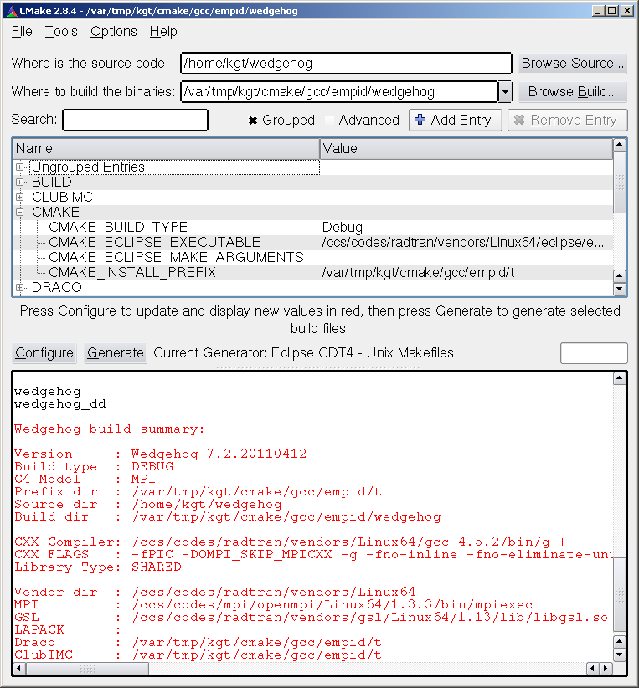
Run it from a GUI…
Useful when using graphical IDE.
Slide <number>

Slide 8
Why use CMake?
Supports platform checks
Good support for 3rd party libraries
  FindBLAS, FindMPI, FindCUDA, …
  Easy to implement custom Find_Package scripts: FindGSL, FindGrace
Easy to maintain build system (lower cost than autotools).
Generic build system is easily ported to other architectures
  Linux, OS/X, YR, TU, CT, RR3.
Modular build system is easily ported to other projects (e.g.: Capsaicin)
  True for most good build systems.
Actively supported and improvements are released at regular intervals.
Slide <number>

Slide 9
CTest is a built-in test framework
Pass/Fail is based on return value
  Optionally can check for regular expression match.
Can run multiple tests in parallel
Easy to select a subset of tests for execution
Dependencies between tests
Provides test time-outs
Instrumentation:
  memory testing via valgrind or purify
  code coverage via gcov or BullseyeCoverage
Slide <number>

Slide 10
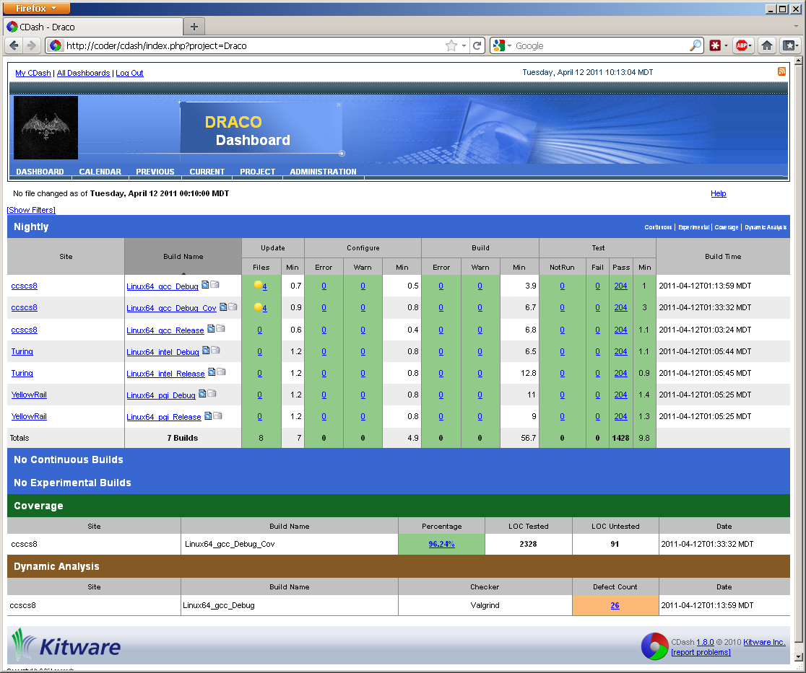
CDash
Slide <number>

Slide 11
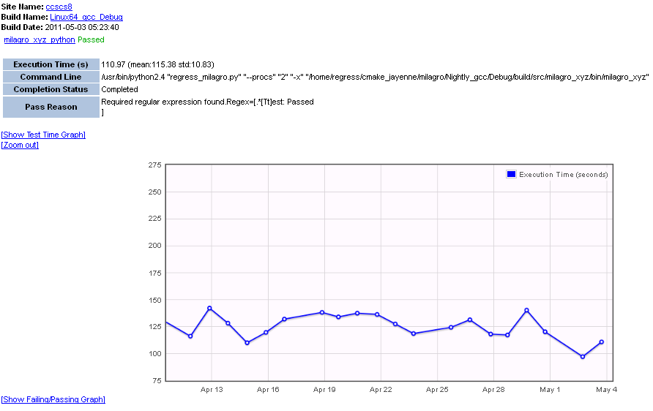
CDash reports execution time for tests
Dashboard is much leaner than MCNP’s test dashboard
Slide <number>

Slide 12
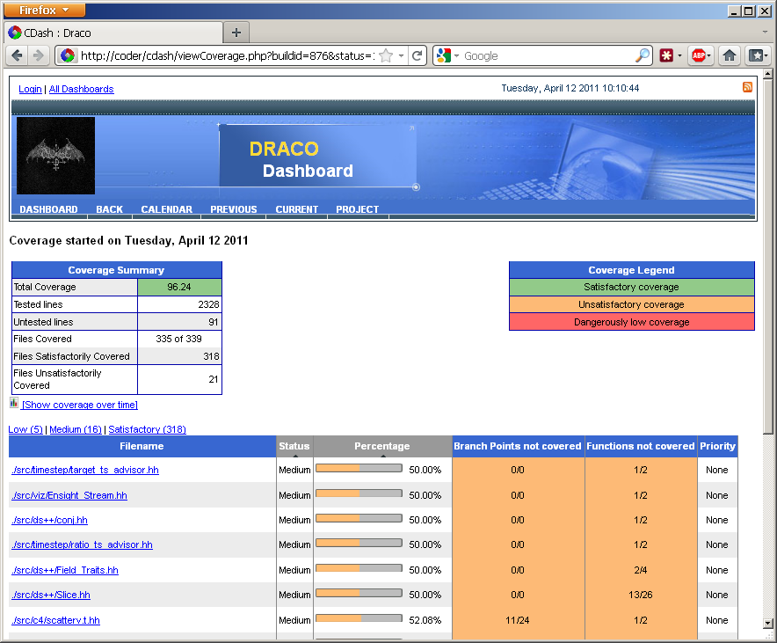
CDash reports ctest results including valgrind/purify, LOC and gcov/bullseye
Slide <number>

Slide 13
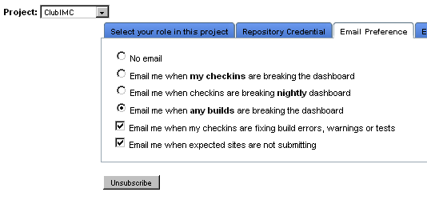
CDash Email
Subscription based
  User’s control when they should be notified.
Simple ‘click for more info’ model.
Subject: FAILED (w=1): ClubIMC - Linux64_gcc_Debug_Cov – Nightly
A submission to CDash for the project ClubIMC has build warnings.
You have been identified as one of the authors who have checked in changes that are part of this submission or you are listed in the default contact list.
Details on the submission can be found at http://coder.lanl.gov/cdash/buildSummary.php?buildid=11730
Project: ClubIMC
Site: ccscs8
Build Name: Linux64_gcc_Debug_Cov
Build Time: 2012-02-02T02:44:10 MST
Type: Nightly
Warnings: 1
*Warnings*
src/imc/test/../Mat_State.hh line 142 (http://coder.lanl.gov/cdash/viewBuildError.php?type=1&buildid=11730)
/.../source/src/imc/test/../Mat_State.hh:142:15: warning: comparison between signed and unsigned integer expressions
-CDash on coder.lanl.gov
Slide <number>

Slide 14
Limitations/Issues
Up-to-date versions not provided by HPC.
  We require 2.8.6+.
Uses its own syntax → initial learning curve.
Limited CDash extensibility (currently cannot post plots, graphics).
  Can attach text files (e.g.: LOC metrics).
Difficult to micro-manage special build commands.
  Special compile flags for a single file.
  Working with assembly output, objdump, etc.
The product is still young as seen by bug count and changing feature set.
Slide <number>

Slide 15
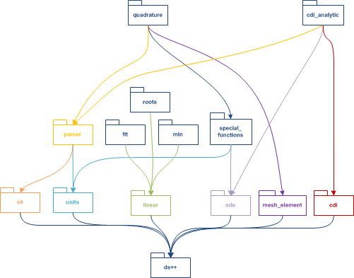
Draco build system
Level, a-cyclic component design
Unit testing for each component
# quadrature/CMakeLists.txt
file( GLOB sources *.cc )
file( GLOB headers *.hh )
include_directories(
${PROJECT_SOURCE_DIR}
${draco_src_dir_SOURCE_DIR}
${dsxx_BINARY_DIR}
${MPI_INCLUDE_PATH} )
add_component_library( Lib_quadrature quadrature "${sources}" )
add_dependencies( Lib_quadrature
Lib_units
Lib_special_functions
Lib_ode )
if( BUILD_TESTING )
add_subdirectory( test )
endif()
Slide <number>

Slide 16
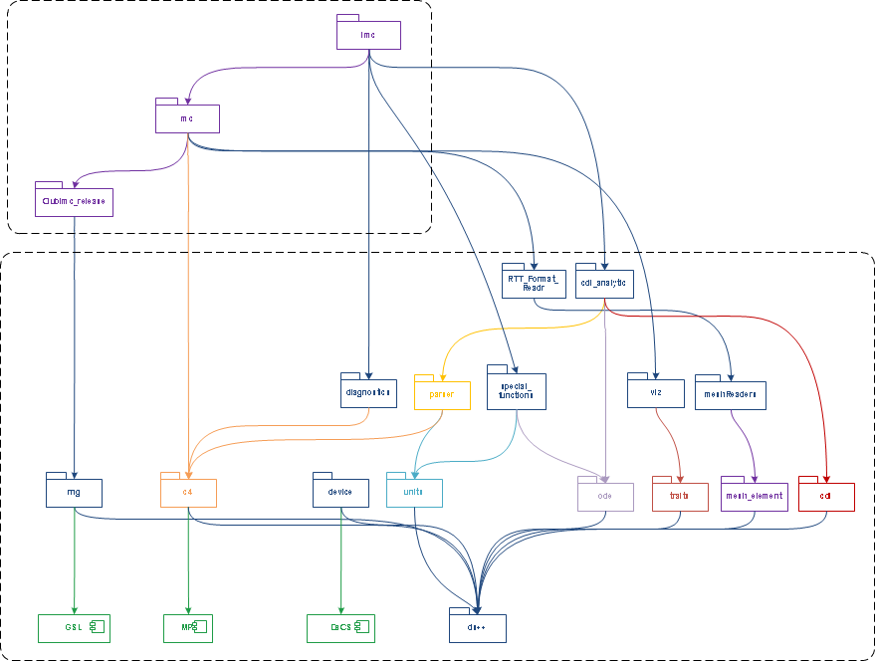

Treat Draco as a vendor…
Slide <number>

Slide 17
Draco build system
All components are assumed to have similar design.
CMake options are used to control system wide settings.
We use standardized CMake target names (e.g.: Lib_quadrature)
#draco/config/component_macros.cmake
macro( add_component_library target_name outputname sources )
add_library( ${target_name} ${DRACO_LIBRARY_TYPE} ${sources} )
if( "${DRACO_LIBRARY_TYPE}" MATCHES "SHARED" )
set_target_properties( ${target_name} PROPERTIES
COMPILE_DEFINITIONS BUILDING_DLL
OUTPUT_NAME ${libraryPrefix}${outputname}
FOLDER ${folder_name} )
endif()
endmacro()
Slide <number>

Slide 18
A note on dependencies
Build system design that focuses on common setup in each package simplifies dependency tracking.
#draco/src/quadrature/test/CMakeLists.txt
project( quadrature_test CXX )
set( test_deps
Lib_parser
Lib_c4
Lib_special_functions
Lib_ode
Lib_dsxx
${GSL_LIBRARIES}
${MPI_LIBRARIES}
${PAPI_LIBRARY} )
add_scalar_tests(
SOURCES "${test_sources}"
DEPS "${test_deps}" )
#draco/config/component_macros.cmake
macro( add_scalar_tests test_sources )
parse_arguments(
# prefix
addscalartest
# list names
"SOURCES;DEPS;TEST_ARGS;PASS_REGEX;FAIL_REGEX;
RESOURCE_LOCK;RUN_AFTER”
# option names
"NONE"
${ARGV} )
...
add_executable( Ut_${compname}_${testname}_exe
${file} )
...
add_test(...)
...
Slide <number>

Slide 19
Results
Lower maintenance cost
  Let someone else maintain the system when possible
  FindVendor
  Targets
Multitool/multiplatform support
  IDE or Makefiles
  Linux, OS/X, Windows, Catamount, etc.
Configure, build and testing speed
  Dependencies tracking
Associated toolset
  CDash
  Release/install capabilities
Slide <number>

Slide 20
Resources
CMake, http://www.cmake.org
Wiki, http://www.cmake.org/Wiki/CMake
“Mastering CMake” book
CMake Mail List Archive, http://www.cmake.org/cmake/help/mailing.html
Slide <number>

Slide 21
Samples
project( dsxx CXX )
configure_file( config.h.in ${PROJECT_BINARY_DIR}/ds++/config.h )
file( GLOB sources *.cc )
file( GLOB headers *.hh )
include_directories(
${PROJECT_SOURCE_DIR} # sources
${PROJECT_BINARY_DIR} ) # config.h
add_component_library( Lib_dsxx ds++ "${sources}" )
install( TARGETS Lib_dsxx DESTINATION lib )
install( FILES ${headers} DESTINATION include/ds++ )
if( BUILD_TESTING )
add_subdirectory( test )
endif()
CMakeLists.txt
Visual Studio Project Files
Unix Makefiles
Eclipse CDT4 Unix Makefiles
Windows SDK
Unix SDK
Slide <number>

Slide 22
Samples continued
% make
Scanning dependencies of target Lib_dsxx
[ 0%] Building CXX object src/ds++/CMakeFiles/Lib_dsxx.dir/Assert.cc.o
[ 0%] Building CXX object src/ds++/CMakeFiles/Lib_dsxx.dir/DynArray_pt.cc.o
[ 1%] Building CXX object src/ds++/CMakeFiles/Lib_dsxx.dir/File_Streams.cc.o
[ 1%] Building CXX object src/ds++/CMakeFiles/Lib_dsxx.dir/Release.cc.o
[ 1%] Building CXX object src/ds++/CMakeFiles/Lib_dsxx.dir/ScalarUnitTest.cc.o
[ 1%] Building CXX object src/ds++/CMakeFiles/Lib_dsxx.dir/UnitTest.cc.o
[ 2%] Building CXX object src/ds++/CMakeFiles/Lib_dsxx.dir/isFinite_pt.cc.o
[ 2%] Building CXX object src/ds++/CMakeFiles/Lib_dsxx.dir/Slice_pt.cc.o
[ 2%] Building CXX object src/ds++/CMakeFiles/Lib_dsxx.dir/Homogeneous_New.cc.o
[ 2%] Building CXX object src/ds++/CMakeFiles/Lib_dsxx.dir/dbc_pt.cc.o
[ 3%] Building CXX object src/ds++/CMakeFiles/Lib_dsxx.dir/to_string_pt.cc.o
Linking CXX shared library librtt_ds++.so
[ 3%] Built target Lib_dsxx
Scanning dependencies of target Lib_dsxx_test
[ 3%] Building CXX object src/ds++/test/CMakeFiles/Lib_dsxx_test.dir/ds_test.cc.o
Linking CXX shared library librtt_ds++_test.so
[ 3%] Built target Lib_dsxx_test
Scanning dependencies of target Ut_dsxx_tstAllocators_exe
[ 3%] Building CXX object src/ds++/test/CMakeFiles/Ut_dsxx_tstAllocators_exe.dir/tstAllocators.cc.o
Linking CXX executable tstAllocators
Slide <number>

Slide 23
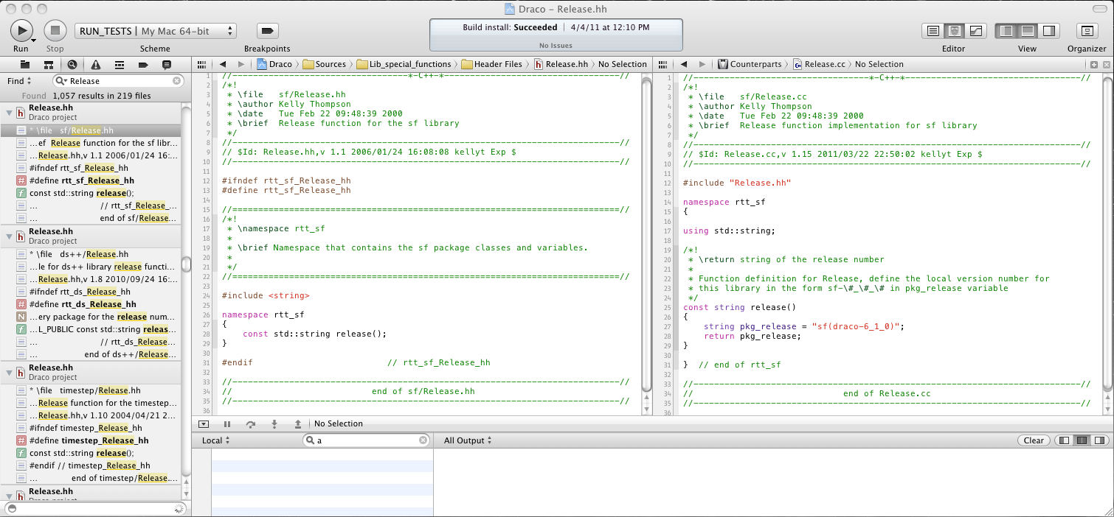
Samples continued
% cmake -G Xcode ../../draco; open Draco.xcodeproj
Slide <number>

Slide 24
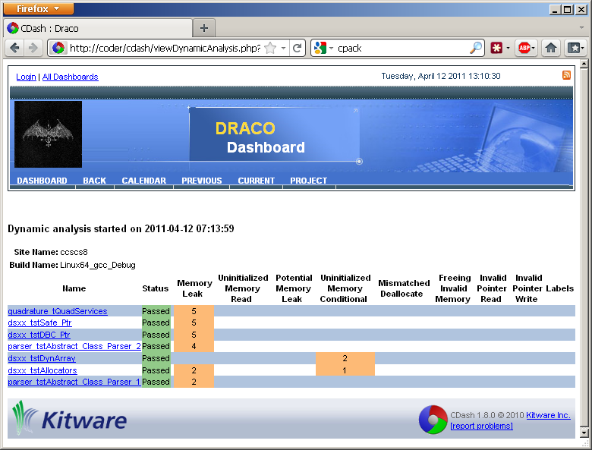
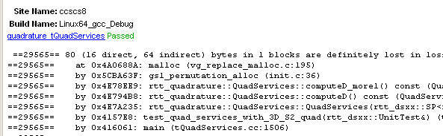
Valgrind
Slide <number>

